Slide 1

CONSUMER GOODS ADHOC INSIGHTs -presented by sharanya shukla
ATLIQ HARDWARES

Slide 2
AGENDA
COMPANY OVERVIEW
INTRODUCTION TO ATLIQ’S MARKET & PRODUCT LINES
BACKGROUND
OBJECTIVE
PROBLEM
APPROACH
ABOUT DATA
ADHOC REQUESTS WITH INSIGHTS

Slide 3
Company overview
Atliq Hardwares (imaginary company) is one of the leading computer hardware producers in the India as well as in 26 other nations across the globe.
Manufactures products under 3 main divisions –
Peripherals & Accessories
PC
Networking & Storage
The company has a total of 74 customers like Neptune,
Sage, Leader and many more across all markets/countries.
S

Slide 4
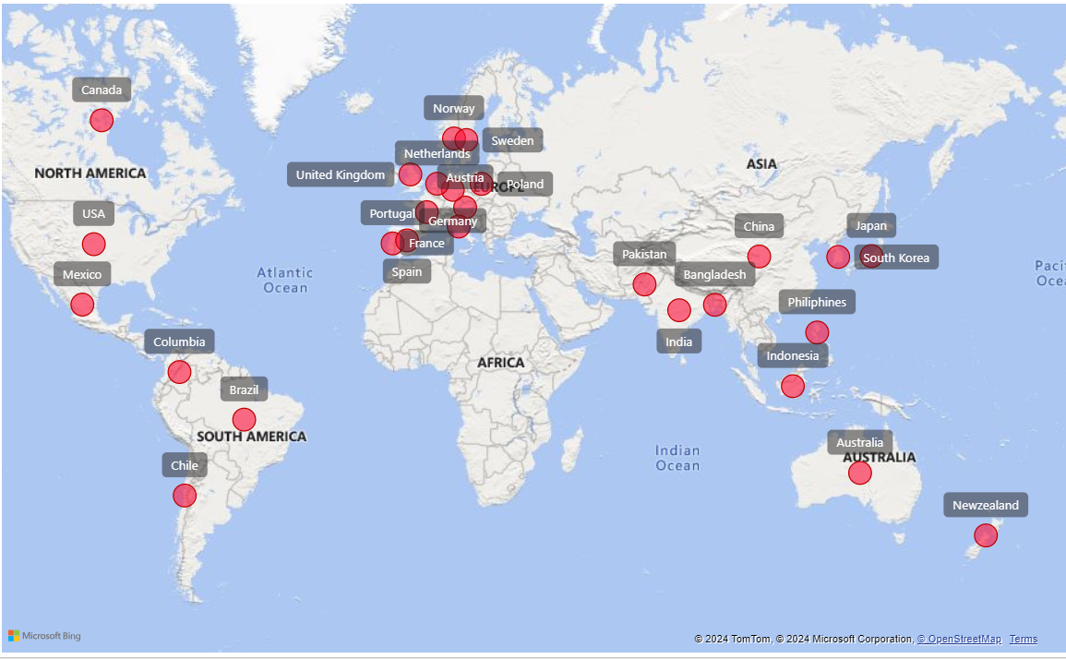
ATLIQ’S MARKETS

Slide 5
ATLIQ’S PRODUCT LINES

Slide 6
P & A
N &S
PC
Networking
Storage
Desktop
Notebook
Peripherals
Accessories
Wi-fi Extender
Batteries
Business Laptop
Gaming Laptop
Graphic Card
Keyboard
USB Flash Drives
Personal Laptop
Internal HDD
External SSD
Business Laptop
Motherboard
Personal Laptop
Mouse
Processors

Slide 7
BACKGROUND
The management noticed that they do not get enough insights to make quick and smart data-informed decisions. They want to expand their data analytics team by adding several junior data analysts. Tony Sharma, their data analytics director wanted to hire someone who is good at both tech and soft skills. Hence, he decided to conduct a SQL challenge which will help him understand both the skills.

Slide 8
OBJECTIVE
Assist the management team to gain more insights about the business.
Take data driven decisions to scale business.

Slide 9
PROBLEM
There are 10 adhoc requests for which the company needs
insights.

Slide 10
APPROACH
Run a SQL query to answer these requests.Convert it into visualisations and present the insights to the top level management .

Slide 11
ABOUT DATA
We have 4 fact tables i.e. sales monthly, manufacturing costs, pre-invoice deductions, gross price which have measurable metrics and 2 dimension tables i.e. customer details and product details.

Slide 12
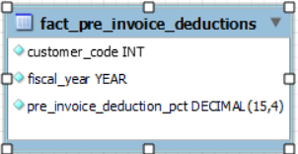
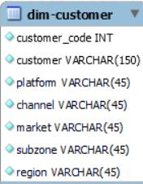
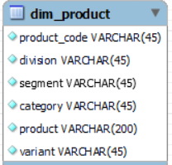
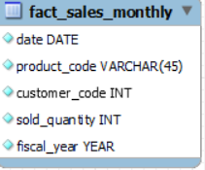
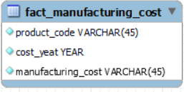
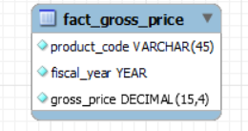

Slide 13
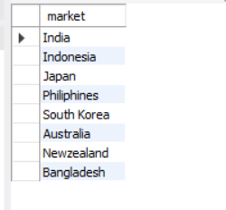

REQUEST 1:
OUTPUT
Provide the list of markets in which customer "Atliq Exclusive" operates its business in the APAC region.

Slide 14
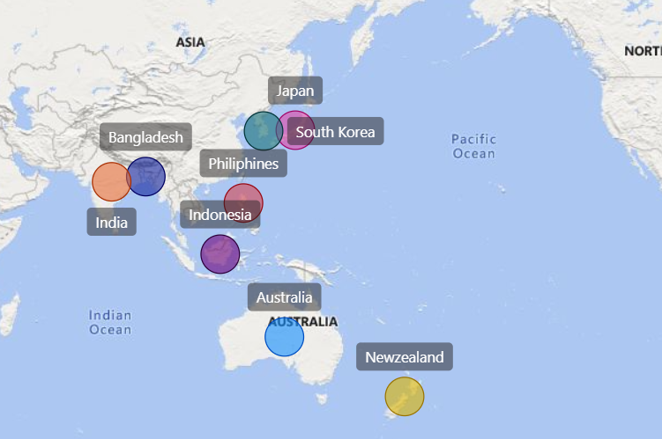
INSIGHTS
In the APAC region,Atliq Exclusive has established its presence in 8 major markets.

Slide 15
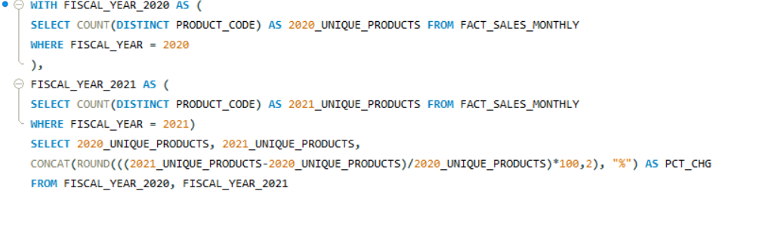
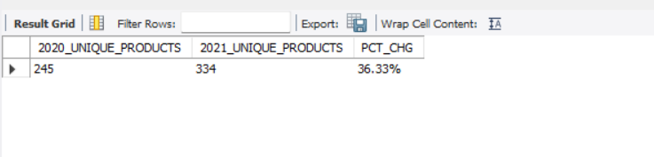
REQUEST 2:
What is the percentage of unique product increase in 2021 vs. 2020? The final output contains these fields:
unique_products_2020 unique_products_2021 percentage_chg
OUTPUT

Slide 16
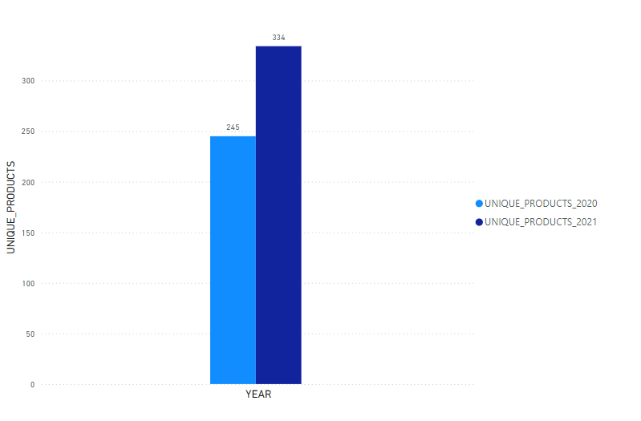
Insights
In FY 2020,we have a total of 245 products
but in FY-2021 ,our count has increased
by 36% to 334 products.

Slide 17
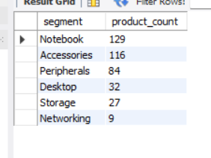
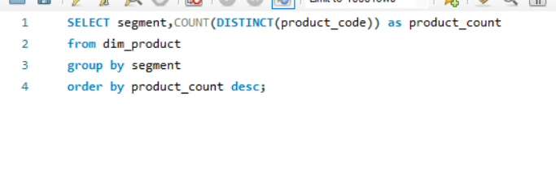
REQUEST 3:
Provide a report with all the unique product counts for each segment and sort them in descending order of product counts. The final output contains 2 fields: segment product_count
OUTPUT

Slide 18
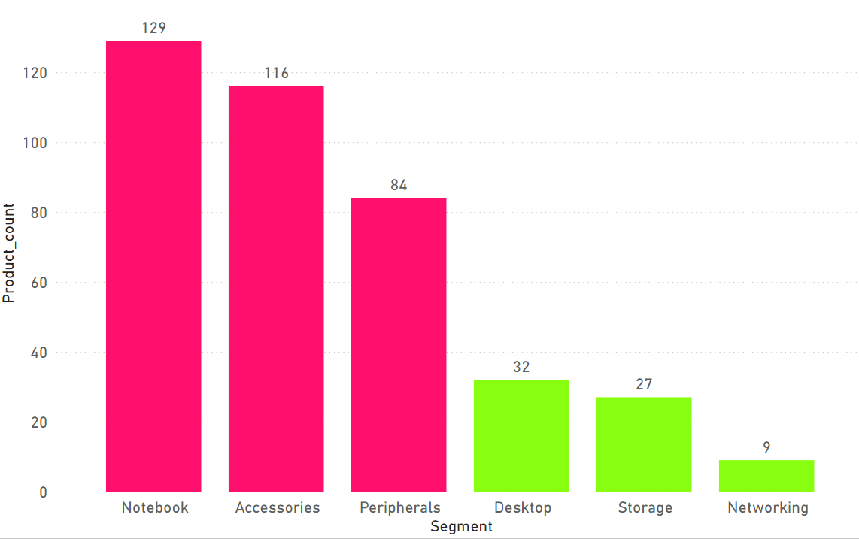
INSIGHTS
The segment Notebook has the highest unique product count of 129 ,followed by accessories and peripherals with a unique product count of 116 and 84 respectively.
Networking segment has the lowest unique product count of 9.

Slide 19
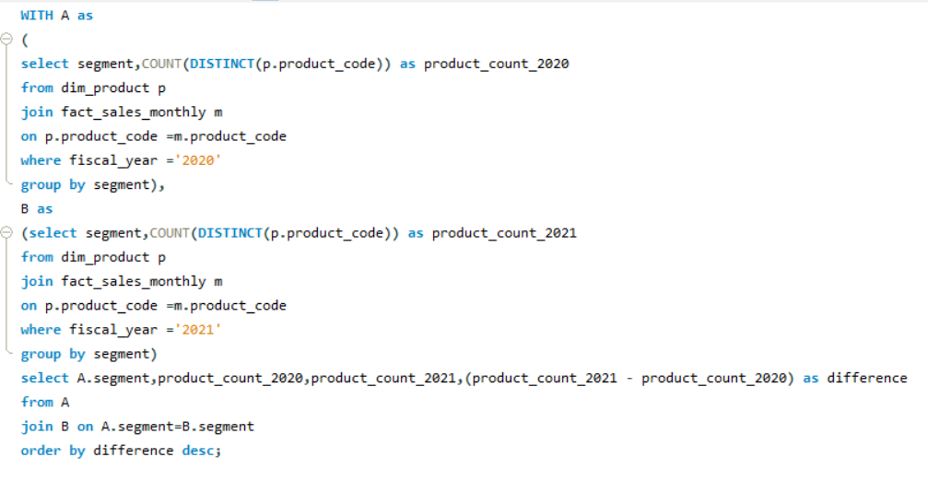
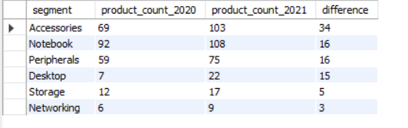
REQUEST 4:
Follow-up: Which segment had the most increase in unique products in 2021 vs 2020? The final output contains these fields: segment product_count_2020 product_count_2021 difference
OUTPUT

Slide 20
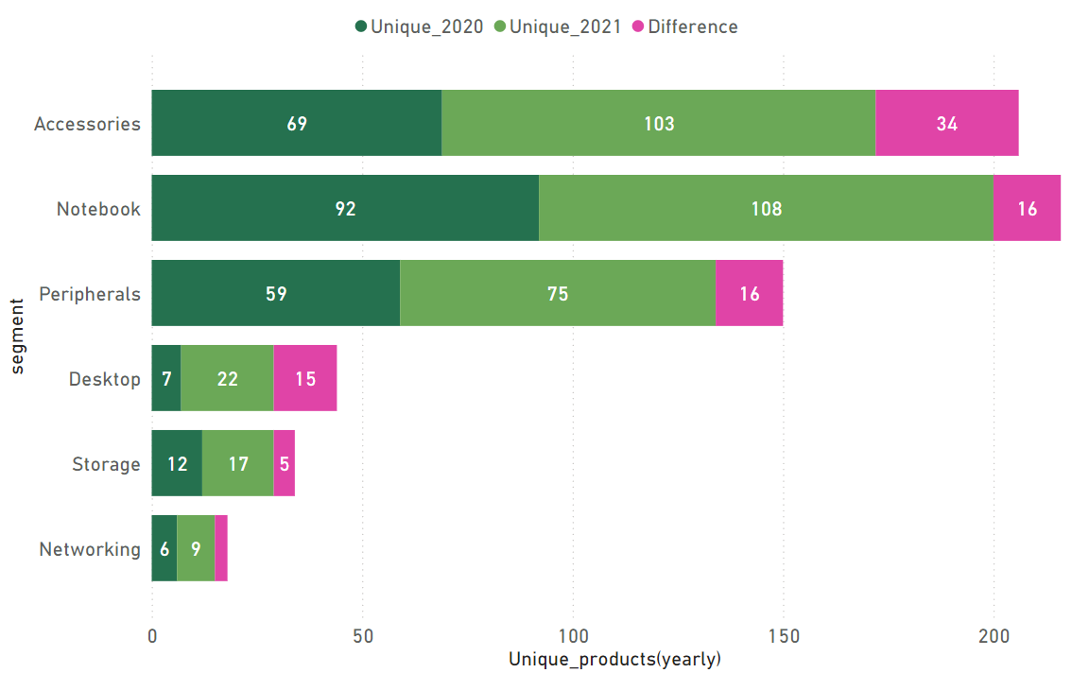
INSIGHTS
With the increase of 34 new products, Accessories segment has the highest number of increase in unique products, followed by Notebook and Peripherals with an increase of 16 unique products each.
Desktop segment has an increase of 15 unique products ,followed by storage with a small increase in unique products as 5
Networking segment has the least number of increase in unique products as 3.

Slide 21
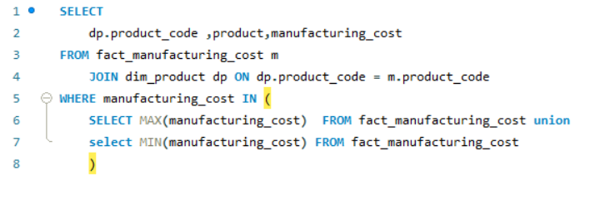
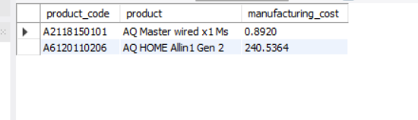
REQUEST 5:
Get the products that have the highest and lowest manufacturing costs. The final output should contain these fields: product_code product manufacturing_cost
OUTPUT

Slide 22


INSIGHTS
AQ Home Allin 1 Gen 2 (Plus 3)
Category : Personal Desktop
Cost: $ 240.5364
AQ Mater Wired x1 Ms (Standard 1)
Category: Mouse
Cost: $0.89

Slide 23
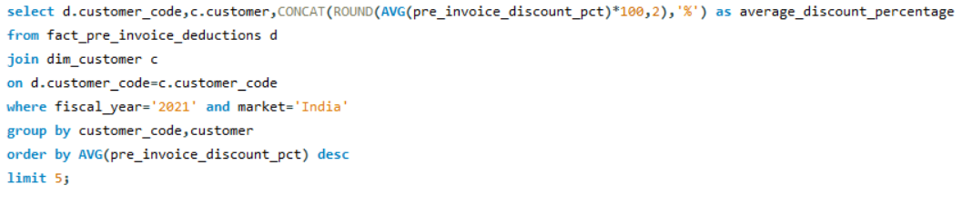
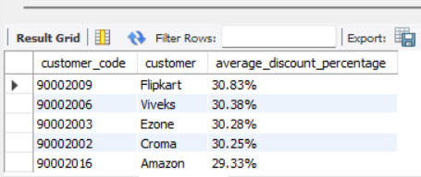
REQUEST 6:
Generate a report which contains the top 5 customers who received an average high pre_invoice_discount_pct for the fiscal year 2021 and in the Indian market. The final output contains these fields: customer_code customer average_discount_percentage
OUTPUT

Slide 24
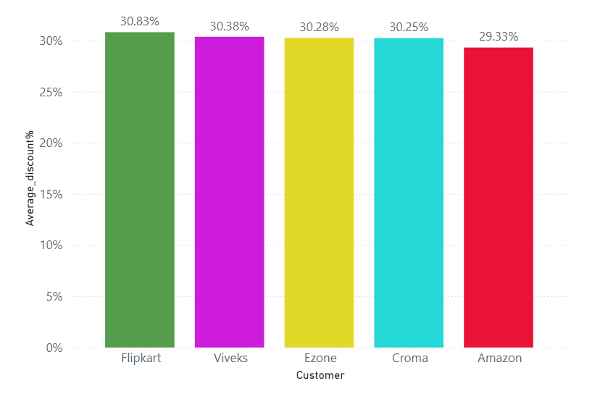
INSIGHTS
Flipkart, Viveks, Ezone, Croma & Amazon are the top 5 customers who have the highest average discount percentage on their orders, ranging between 29.33% - 30.83%.

Slide 25
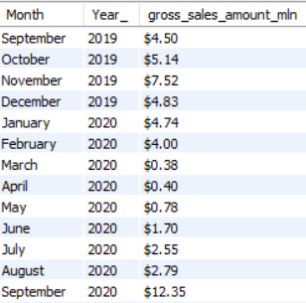
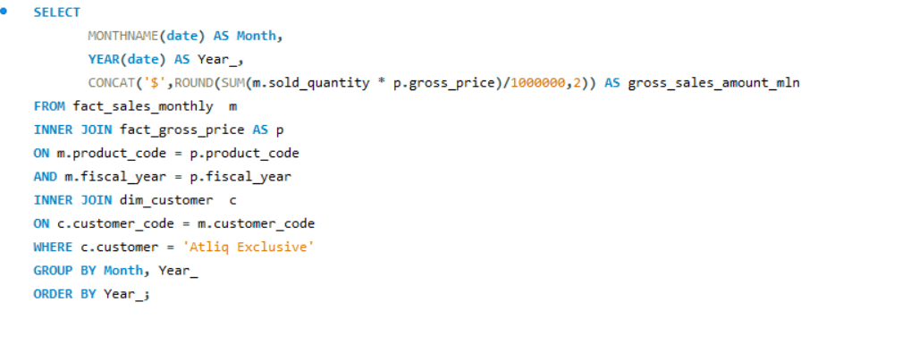
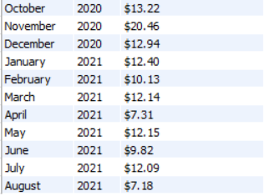
REQUEST 7:
Get the complete report of the Gross sales amount for the customer “Atliq Exclusive” for each month. This analysis helps to get an idea of low and high-performing months and take strategic decisions. The final report contains these columns: Month Year Gross sales Amount
OUTPUT

Slide 26
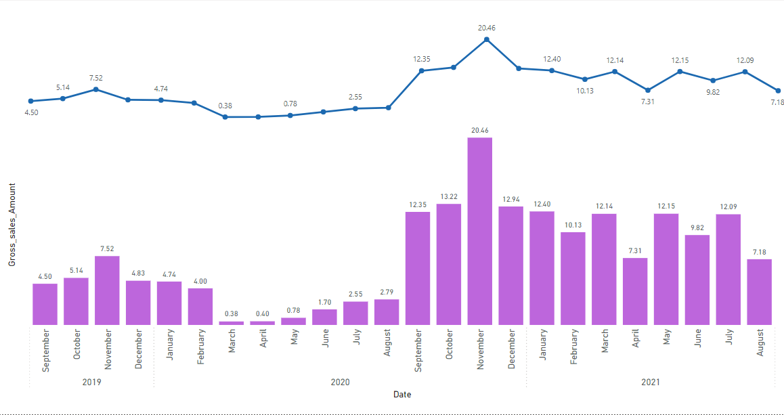
INSIGHTS
For Atliq Exclusive, November 2020 marked the highest sales.
March 2020 marked the lowest gross sales. It’s very evident that lower sales between March and August are because of Covid-19.
However, the sales increased quickly after August and reached the highest level since the last two years in November.

Slide 27
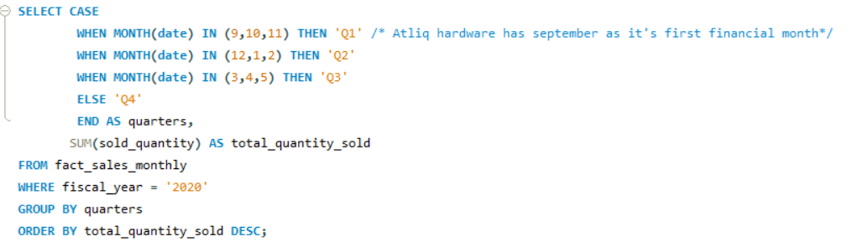
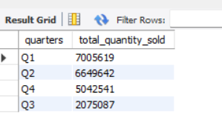
REQUEST 8:
In which quarter of 2020, got the maximum total_sold_quantity? The final output contains these fields sorted by the total_sold_quantity: Quarter total_sold_quantity
OUTPUT

Slide 28
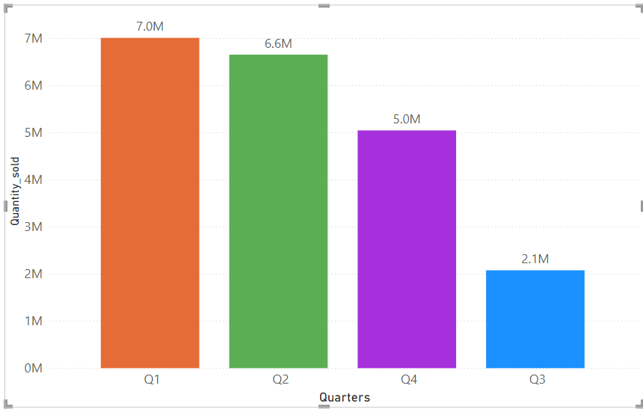
insights
Q1 (September-November) has the highest quantity sold of around 7 M for FY -2020.
Q3 (March-May) has the lowest quantity sold of around 2M for FY-2020 due to Covid-19.

Slide 29
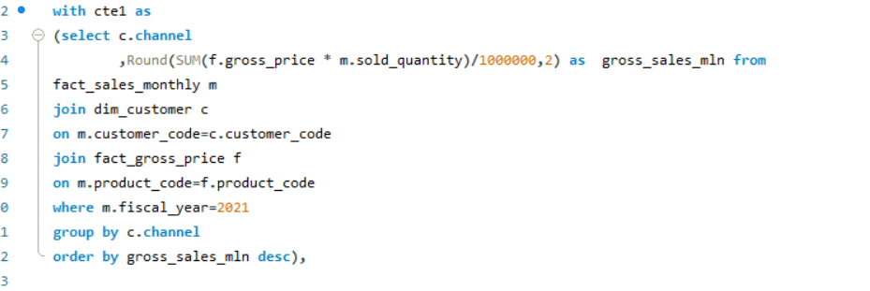
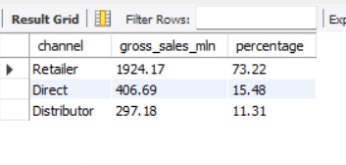
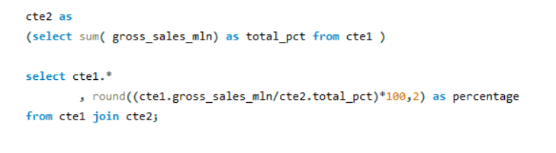
REQUEST 9:
Which channel helped to bring more gross sales in the fiscal year 2021 and the percentage of contribution? The final output contains these fields: channel gross_sales_mln percentage
OUTPUT

Slide 30
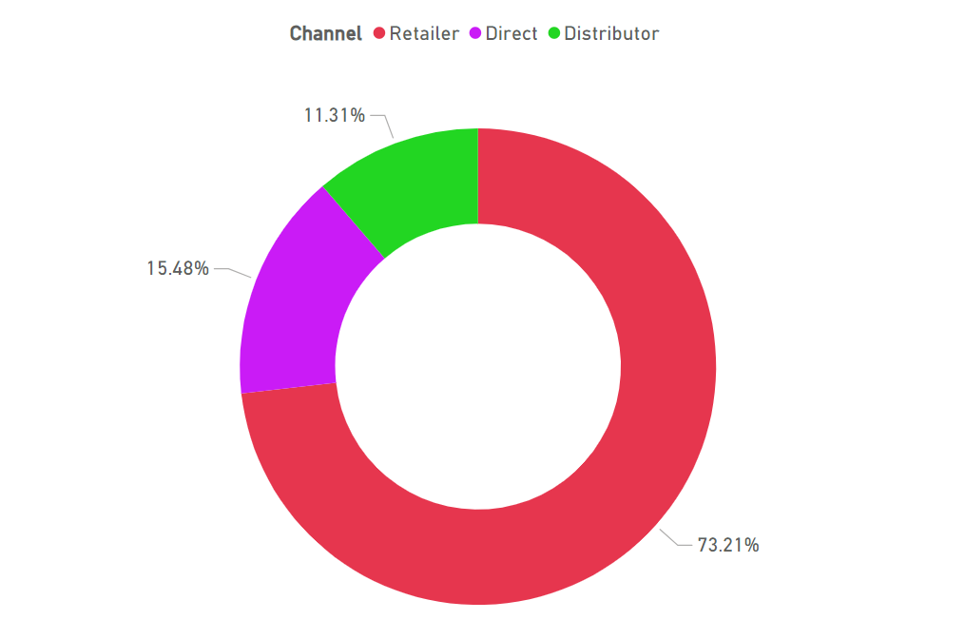
INSIGHTS
Retailer helped to bring highest gross sales in FY-2021 with a percentage contribution of 73.22%.
Distributor had the least percentage contribution of around 11.31% in the FY-2021.

Slide 31
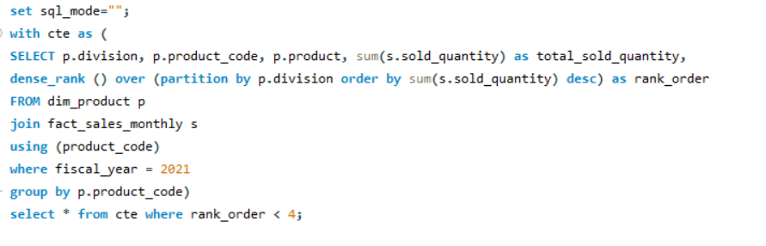
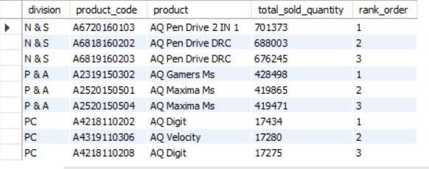
REQUEST 10:
Get the Top 3 products in each division that have a high total_sold_quantity in the fiscal_year 2021? The final output contains these fields:division, product_code, product, total_sold_quantity, rank_order
OUTPUT

Slide 32
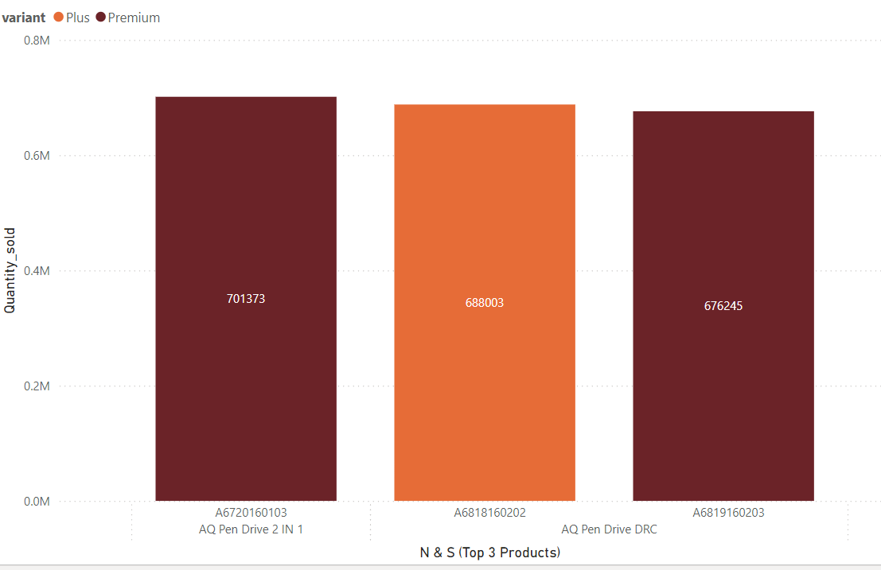
INSIGHTS
The top 3 selling products in N&S were pendrives, which were around 7 lakh in quantity.

Slide 33
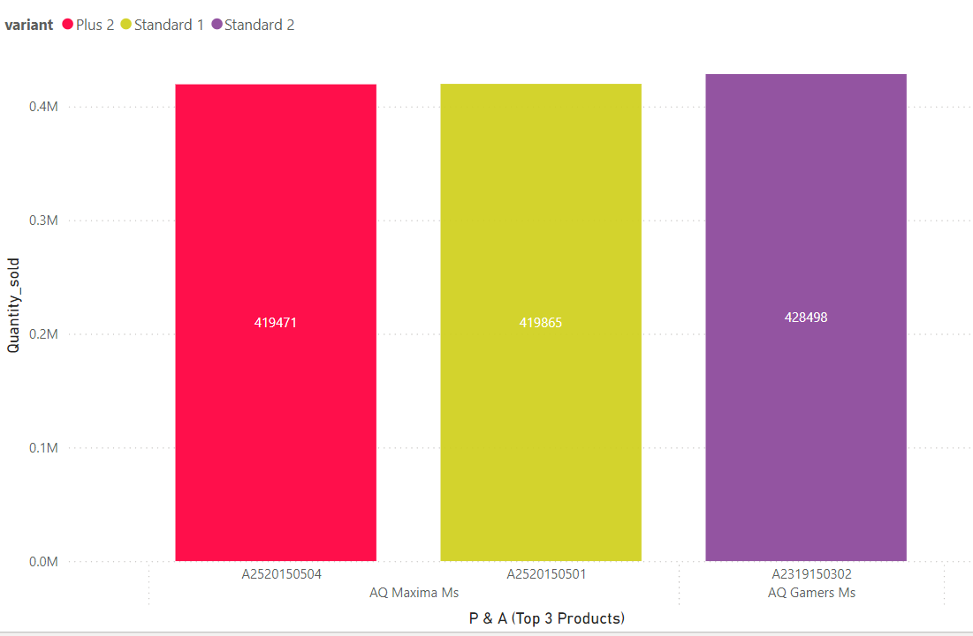
The top 3 selling product in P & A were mouse, which were around 4 lakh in quantity.

Slide 34
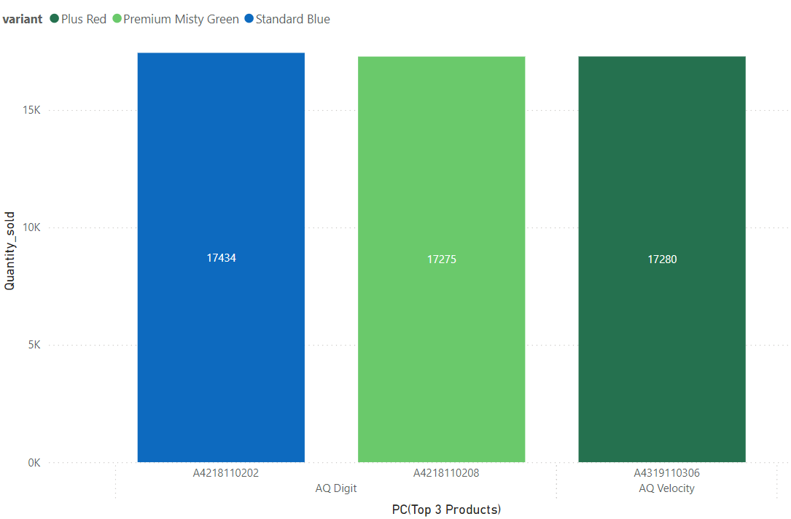
The top 3 products in PC were personal laptops, which were around 17,000 in quantity.

Slide 35

Thank you

